Slide 1
Chapter 4:
Corporate Social Responsibility
Contemporary Issues in Social Accounting

Slide 2
Chapter Structure
What is CSR ?
Corporate Citizenship
  Milton Friedman
  Charles Handy
  Limitations of corporate citizenship
  Strategic Approach to CSR Implementation
  Stakeholder Engagement.
  CSR/Sustainability Reporting.

Slide 3

What is CSR?
What do you think CSR is ?
The term ‘company’ is derived from two Latin words, cum and panis, meaning ‘breaking bread together’.
Relationship between companies and society.
Students Group Discussion

Slide 4

What is CSR?
The concept of CSR emerges from the argument that organisations need to satisfy not just shareholders but their entire stakeholders.
CSR can only be defined by looking at its various dimensions.
CSR dimensions include: environmental dimension, social dimension, economic dimension, stakeholder dimension and voluntariness dimension (Dahlsrud, 2008).

Slide 5
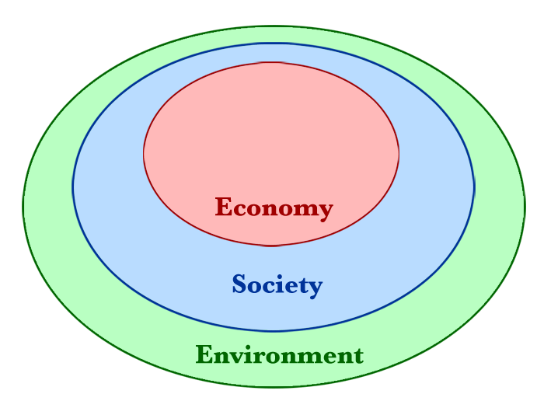
CSR defined
corporate [social responsibility] refers to company activities – voluntary by definition – demonstrating the inclusion of social and environmental concerns in business operations and in interactions with stakeholders (Van Marrewijk, 2003).

Slide 6

CSR defined- continuation
According to Davis (1973), CSR is the firm’s considerations of, and response to, issues beyond the narrow economic, technical, and legal requirements of the firm to accomplish social [and environmental] benefits.

Slide 7
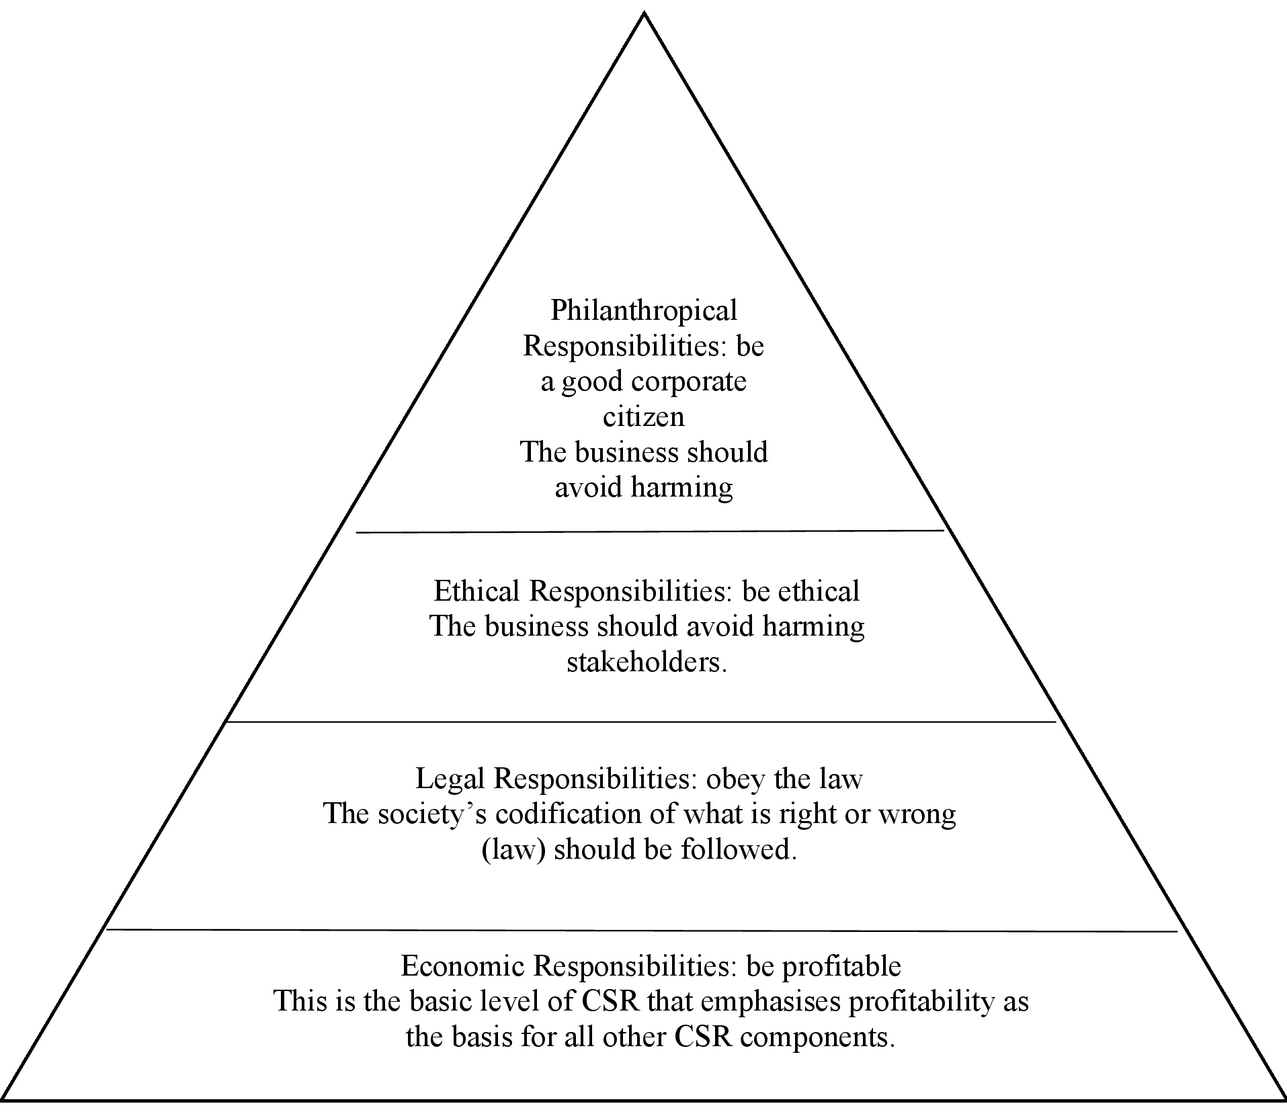
What is CSR?
CSR Pyramid- Carroll (1991)

Slide 8

Corporate Citizenship
Can we treat a corporation as a person? Should we expect corporations to behave according to human ethics and morals?
If yes, how can a corporation being composed of many people with diverse backgrounds do so?
What set of social norms should a corporation adhere to? Is it those that are defined by its shareholders, the government or social activists?

Slide 9
Corporate Citizenship
Labour rights issues:
child labour
forced labour
right to organise
safety and health
Environmental issues:
water & air emissions
climate change
Human rights issues:
cooperation with paramilitary forces
complicity in extra-judicial killings
Social issues:
Job creation
public revenues
skills and technology
Examples of Key Issues in CSR

Slide 10


Corporate Citizenship
CSR’s Disadvantages
CSR’s Advantages
Milton Friedman.
Theodore Levitt.
Agency theory
Charles Handy.
Stakeholders theory.
Institutional theory.
Cause- related marketing.

Slide 11

Corporate Citizenship
CSR is “a happy new orthodoxy, a prevailing vogue, a new tyranny of fad and fancy”…Theodore Levitt (1958).
CSR is “fundamentally subversive doctrine in a free society”… The Nobel Prize winning economist, Milton Friedman (1970).
Obligations suggested by CSR proponents have more harmful effects than good…David Henderson (2001)

Slide 12

Corporate Citizenship
Companies’ number one duty to society is to maximise returns to its shareholders, and any attempts to spend money on social/environmental donations, or attempt to satisfy stakeholders other than shareholders, were at best misguided.
Money invested in CSR activities is a ‘theft’ of shareholder-owned resources that should be used instead to maximise shareholders’ wealth.
Many CEOs – in developed countries – found that making their operations sustainable is a disadvantage compared to developing countries’ competitors who do not face the same pressures.

Slide 13

Corporate Citizenship
Charles Handy, an influential British commentator, disagrees with the previous view of the role of firms in society. He believes on the moral imperative embedded in the business – society relationship.
In Handy’s view, firms are expected to do something valuable to the ‘whole society’ and to do it “better, or more useful than anyone else” (Handy, 2002).

Slide 14
Corporate Citizenship
Firms need more than just generating profits to justify its existence, and their profits should be just “the means to that larger end”.
Corporations are committed to bear social responsibilities as an ethical obligation regardless of any other financial consequences (Garriga & Melé, 2004).

Slide 15

Corporate Citizenship
Are Friedman’s and Handy’s views reconcilable ?
Can CSR activities increase its profits ?
Firms with good CSR agenda do perform well financially ?
a number of ‘pragmatic’ theories are used to explain the positive relationship between CSR and corporate financial performance: the cause-related marketing, Stakeholder theory, ..etc.

Slide 16


Strategic CSR
What are the limitations of the traditional/philanthropic CSR ?
Students Group Discussion
What is strategic CSR ?

Slide 17

Limitations of traditional CSR
No clear political or legal framework that defines the rights and responsibilities of corporation.
The universality of normative (e.g. Whose norms? Why those norms and not any other?).
Lack of monitoring and accountability
A distorted situation in which firms are “responsible for everything and accountable for nothing”.
The absence of accountability systems where companies are fared well for their misconduct, eventually encourages the use of CSR activities for ‘greenwashing’.

Slide 18

What is Strategic CSR
Strategic CSR goes beyond the so-called responsive CSR to mount a small number of initiatives that largely and distinctively benefit both society and business.
Strategic CSR is about rooting CSR in the strategies of specific companies, hence, firms should engage only in eco-social activities related to its core business.
The more closely tied an eco-social issue is to a corporation’s core activity, the greater the chance to benefit both society and corporation.

Slide 19

Strategic CSR
Identifying the Points of Intersection between a Company and Society.
Choosing which Social Issues to Address.
Creating a Corporate Social Agenda.
Integrating Inside-Out and Outside-In Practices.
Creating a Social Dimension to the Value Proposition.

Slide 20
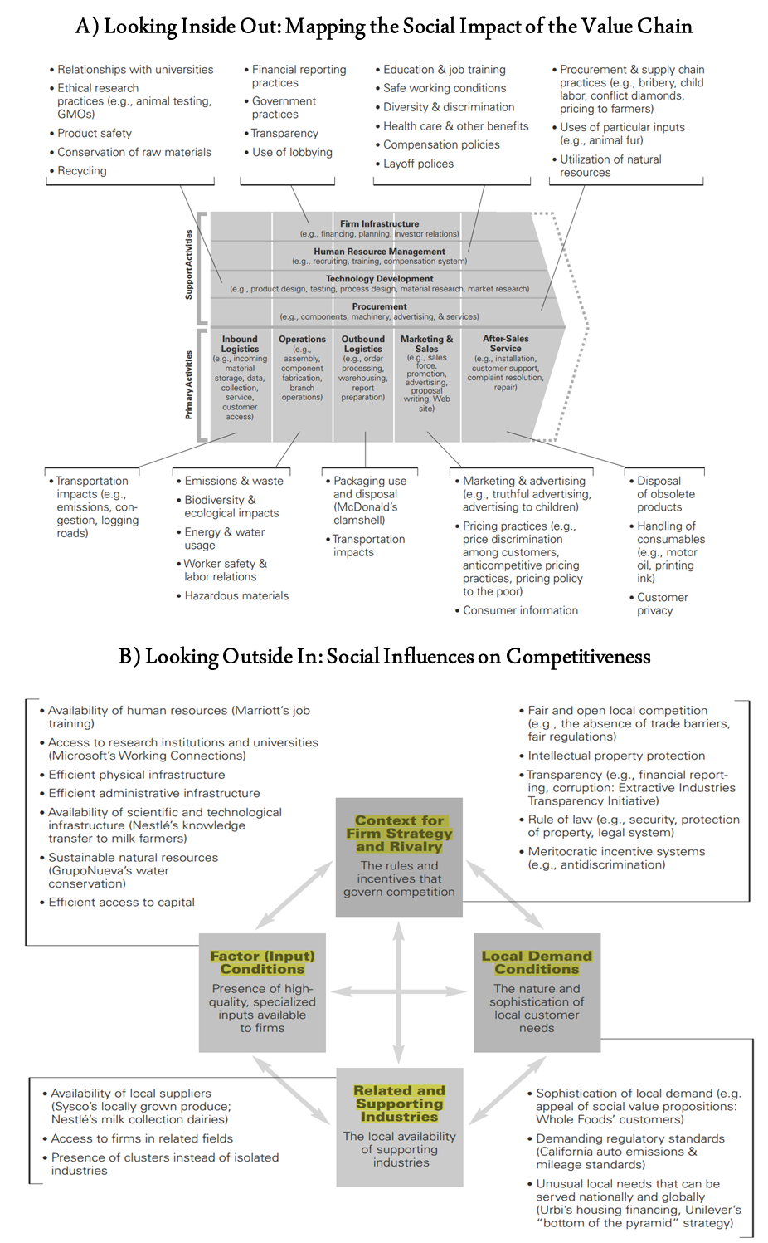
Identifying the Points of Intersection between a Company and Society
Looking Inside out

Slide 21
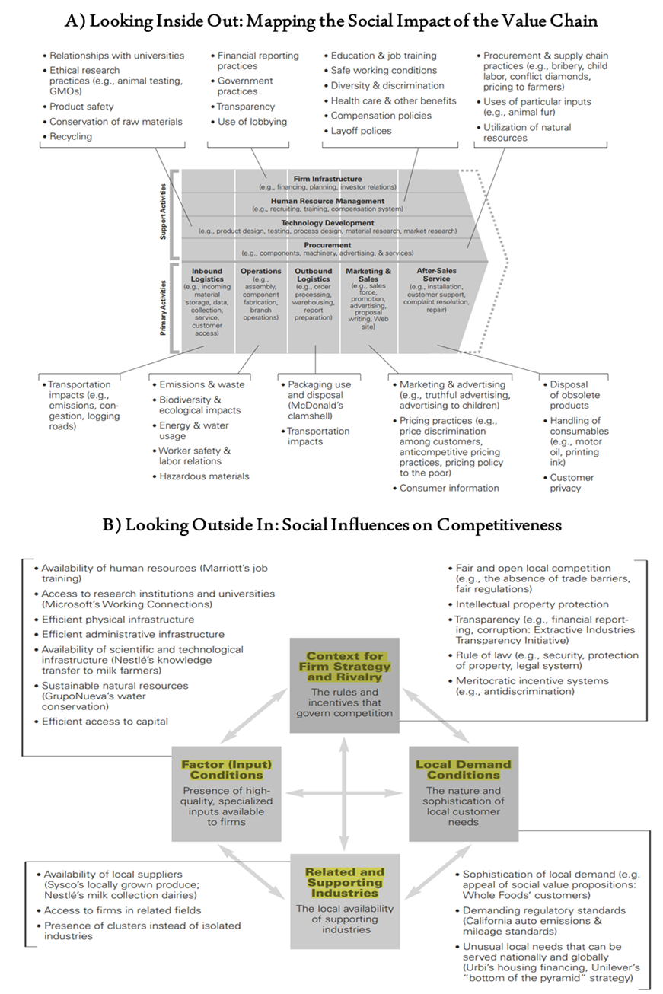
Identifying the Points of Intersection between a Company and Society
Looking Outside In

Slide 22
Choosing which Social Issues to Address
Generic Social Issues | Value Chain Social Impacts | Social Dimensions of Competitive Context
Social issues that are not significantly affected by a company’s operations nor materially affect its long-term competitiveness. | Social issues that are significantly affected by a company’s activities in the ordinary course of business. | Social issues in the external environment that significantly affect the underlying drivers of a company’s competitiveness in the locations where it operates.
Source: Porter and Kramer (2006)

Slide 23

Creating a Corporate Social Agenda
A categorised and ranked list of the social issues that can be used to create CSR agenda.
The vast majority of the firm’s resources should be devoted to the strategic CSR activities.
CSR agenda can include few activities that are responsive to the different needs of stakeholders (i.e. responsive CSR).

Slide 24

Integrating Inside-Out and Outside-In Practices.
While value chain-based social innovations and the ones targeting competitive context have the potential to significantly benefit the society and business on its own right, the impact is even greater if they are combined.
A firm, for instance, can focus on a CSR activity that helps its main operations (value chain) while enhancing its input quality (competitive context).

Slide 25
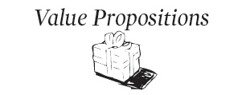
Creating a Social Dimension to the Value Proposition.
Value proposition is defined as the set of needs that a particular firm attempts to fulfil better than anyone else.
The best strategic CSR activity is the one that is built on adding social dimension to the firm’s unique value proposition, achieving the ultimate integration between social component and strategy.

Slide 26

Stakeholder Engagement
Stakeholder engagement is “the process of seeking stakeholder views on their relationship with an organisation in a way that may realistically be expected to elicit them” (ISEA, 1999, p. 91).
Levels of stakeholder engagement include: Stakeholders are merely given Information (passive); Stakeholders are consulted (listening); Stakeholders engage in dialogue with company (two-way process); Management is driven by stakeholder (proactive)

Slide 27
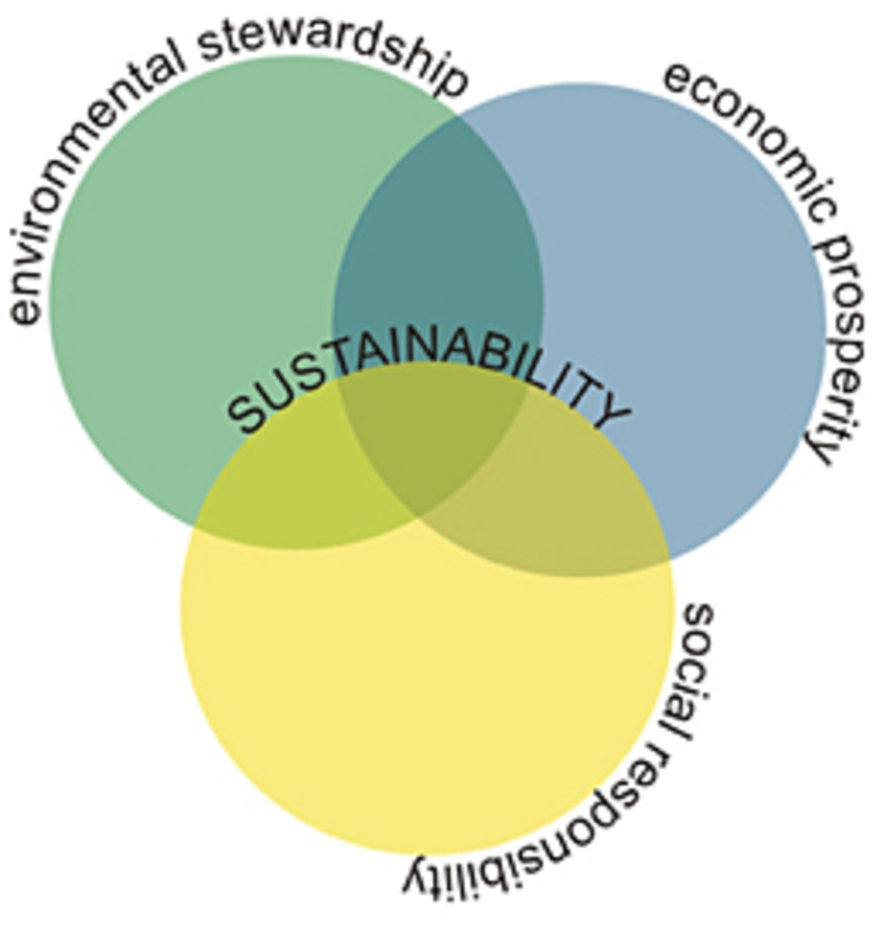
CSR/Sustainability Reporting
What is sustainability?
“Achieving sustainability requires balancing the complex relationships between current economic, environmental, and social needs in a manner that does not compromise future needs” (Global Reporting Initiative (GRI), 2002, p. 9).

Slide 28
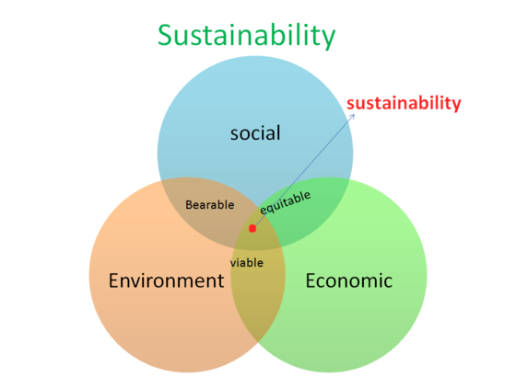
CSR and sustainability compared
A major distinction between sustainability and CSR is that the former requires carrying out CSR activities with a future orientation, hence, CSR is sustainability in the short-term. ​
Sustainability typically involves integrating the triple bottom-line into business strategies and processes. The triple bottom-line include economic (profit) issues, social issues and environmental issues. ​

Slide 29
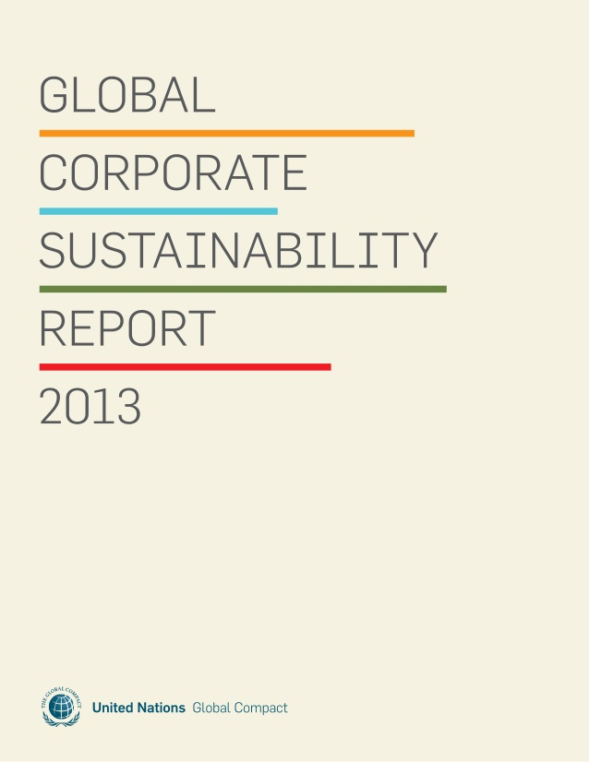
CSR reporting
[CSR] reporting deals with the disclosure of information by an organisation about product and consumer interests, employee interests, community activities and environmental impacts—this disclosure of information is deemed to be a part of an organisation’s responsibility to its stakeholders or a response to stakeholder expectations (Islam, 2015, p. 15).

Slide 30
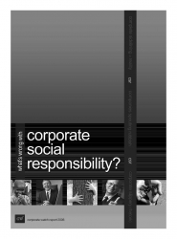
CSR reporting continued
Deegan (2007) defines [CSR] reporting as the provision of information about the performance of an organisation in relation to its interaction with its physical and social environment and includes, but is not limited to interaction with the local community; level of support for community projects; level of support for developing countries; health and safety record; training, employment and education programs; and environmental performance (p. 1265).

Slide 31

CSR reporting standards
AA1000 Assurance Standard (AA1000AS) issued by AccountAbility in 2008,
International Standard on Assurance Engagements (ISAE3000) developed by the International Auditing and Assurance Standard Board (IAASB) in 2013 and
Sustainability Reporting Guidelines, issued by the Global Reporting Initiative in 2006.
GRI is the most comprehensive

Slide 32
GRI guidelines
External assurance
External assurance conducted by independent groups or individuals
Preparation of assurance report should be systematic, documented, evidence-based, and characterised by defined procedures.
The veracity of data in a report as well as the overall content selection should be considered.

Slide 33
GRI guidelines continued
No conflict of interests to reach and publish an independent and impartial conclusion on the report.
Assurance should state the extent to which the report preparer has applied the GRI Reporting Framework.
Assurance should state the relationship between the assurance provider on and the report preparer.

Slide 34
Summary
The whole idea about CSR is yet to be put together into a cohesive whole
This chapter unveils and integrates insights into a whole lot of issues about CSR
CSR defined, dimensions of CSR, levels of CSR activities, theoretical arguments for CSR, strategic CSR, stakeholder engagement, CSR/sustainability and CSR reporting

